Slide 1
Computer Graphics
Strategies for Success in a Hybrid Learning Environment

Slide 2
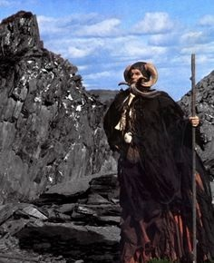
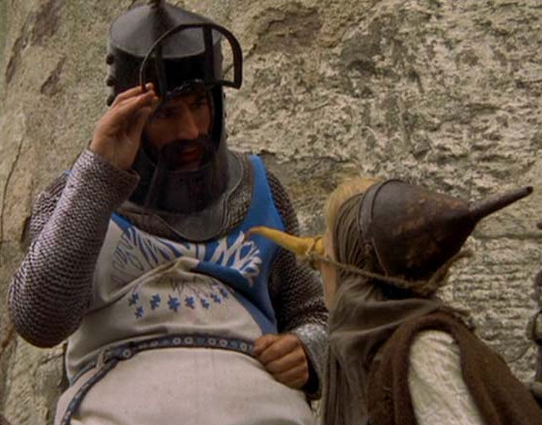
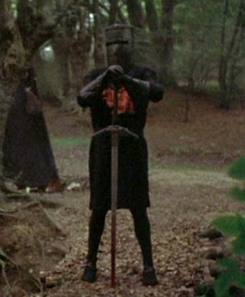
The Archetypes… Which Best Describes You?
Inquisitor
Implementer
Absorber

Slide 3
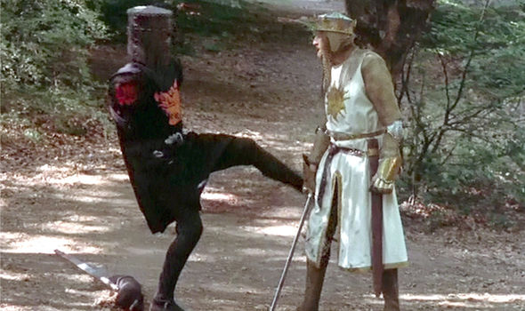
Absorber: Strengths & Weaknesses
Long attention span, solid work ethic
Not easily deterred “Dog with a bone”
Quickly grasps the flow of an assignment
Strong grasp on core theories (The Forest)
Programming may not come naturally
Often confused on where to start
Can struggle with algorithm details (Trees)
Debugging skills may need some work

Slide 4
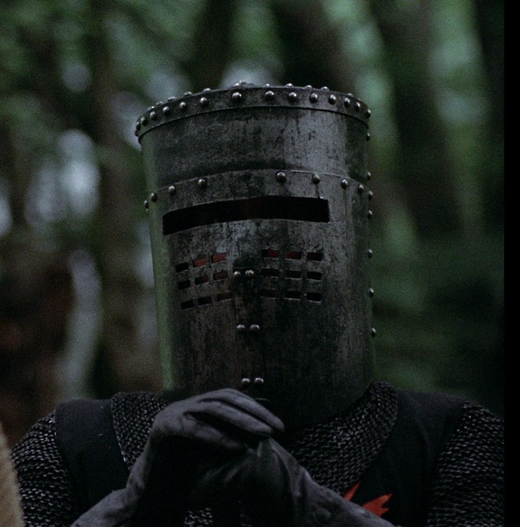
Recommended Strategies
Complete the entire lesson exactly as provided
Increase playback speed to 1.25X to save time
Take regular breaks to increase absorption rate
Lecture time may feel redundant, use this time instead to get a head start on your lab assignment (once all your questions have been answered)
Programming bugs will be your Achilles heel, attend tutor/lab/office hours whenever possible
You may struggle with the hardware project, send your professor an email if you get really stuck. Be very detailed about where you are stuck
Your understanding of the fundamental theory will be stronger than other students, lend them your understanding during group activities.

Slide 5
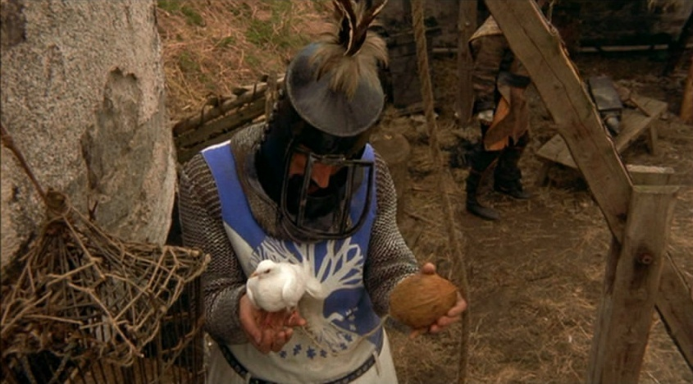
Inquisitor: Strengths & Weaknesses
Highly skeptical, observant & curious
Detail oriented, enjoys/prefers reading
Excellent debugging skills (once developed)
Late Bloomer, Natural problem solver
Can get distracted/bored easily (daydreamer)
Needs a problem or puzzle to learn effectively
Gets so absorbed in one problem, can forget what they were trying to do in the first place
May have a fairly underwhelming work ethic unless a topic interests them

Slide 6
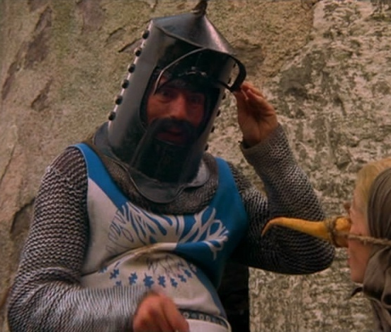
Recommended Strategies
Instead of watching the videos from start to end, focus on answering the questions using your reading/research skills (enable auto captions)
Jump to the last few minutes of the last video & write down the valuable reading assignment
Use the book to get up to speed quickly on a topic while taking notes and writing down questions
Increase playback speed to 2X to find something specific in a video (then slow it down)
Lecture time is CRITICAL for you, come prepared with LOTS of questions! (failure to do so can be extremely harmful)
During group activities use your natural debugging skills to help your teammates figure out why their code that should work… doesn’t work

Slide 7
Implementer: Strengths & Weaknesses
Natural coder, logic/syntax comes easily
Can “dive right in” and usually come out ok
Picks up new coding techniques quickly
Confident in abilities, powerful work ethic
Highly agitated when they get stumped by something (can handle frustration poorly)
Prone to “Hack” solutions together
Grasp of material is often wide but not deep
Little patience for reading or videos (code!)

Slide 8
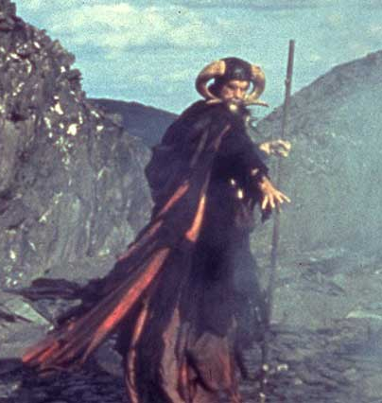
Recommended Strategies
Watch each video just long enough to grasp the basic concept (skip ahead to the example)
In the area below the video write C++/pseudo code that will perform the task the video covers (ex: computing the gradient vector)
Refer back to the math/logic examples in the videos to help you write the core algorithm
In lecture discuss the logic you wrote with your instructor & classmates, they can help confirm if your base concept is sound
Utilize your new functions to quickly complete labs
In lecture try and connect what you have learned to your favorite games to enhance comprehension
Take the lead during group activities, your practical skills will make you a major asset to your team

Slide 9
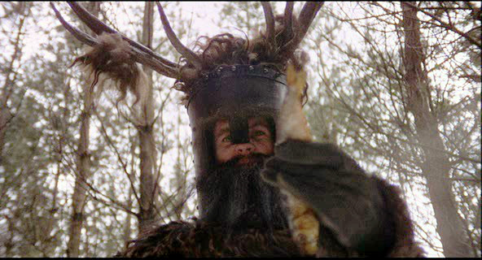
Final Reminders
Obviously not every student falls neatly in one of these archetypes but you can freely mix & match recommendations to match your own personal style.
Regardless of which style you pick remember there is no “just wing it” style. Adequate preparation is key in any hybrid classroom environment.
Try your best to turn-in your labs within the first 24 hours so you have adequate time to prepare for the next class meeting.
Don’t forget to SUBMIT your online lesson a minimum of 30min before the start of class to get attendance credit. You must score at least one question right or have a minimum of two hours logged watching videos/writing code.

Slide 10
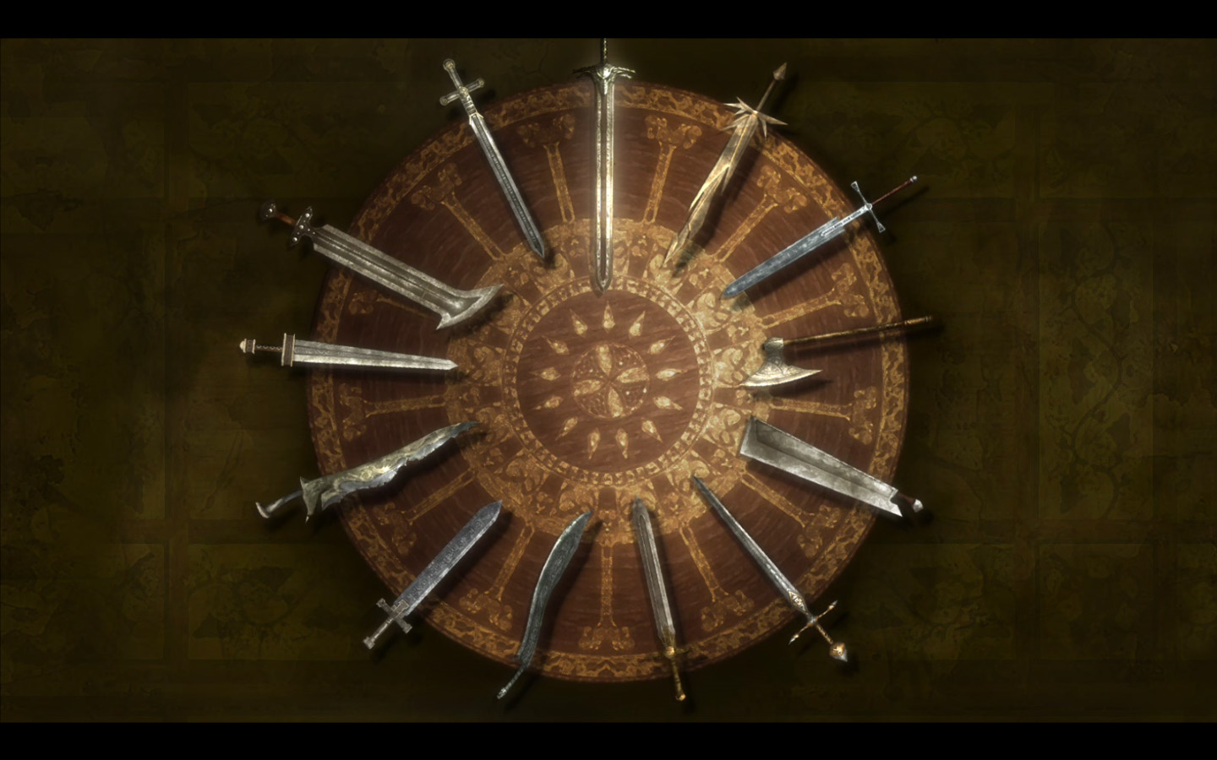

Knights of the Round Table
Jordan Bracken
Shawn Richmond
Michael Jones
Jonathan Long
Garret Davis
Tom Devaney
Nicholas Lee
Holden Olivier
Joshua Stankiewicz
Cody Ngo
Junshu Chen
Nhu Yen Nguyen
Joshua Fetsch
http://killapenguin.com/227/gallery/medium/kingarthur/king-arthur-0191.jpg

Slide 11
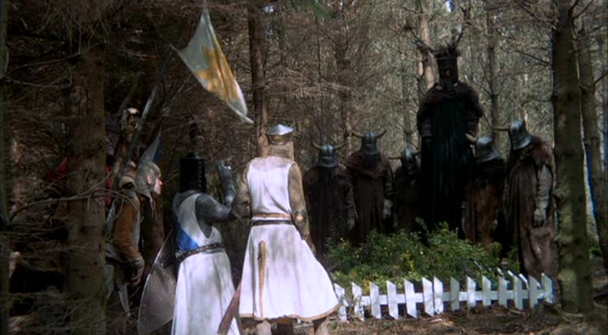
Knights who say Ni!
Matthew Zanini
Frank Bocchino
Jonathan Gyurkovics
Hunter Allen
Stephen Kerney
Un Sung Yoo
Shiyang Ao
Marshall Yeung
Xiuchen Que
http://www.intriguing.com/mp/_pictures/grail/large/HolyGrail141.jpg

Slide 12
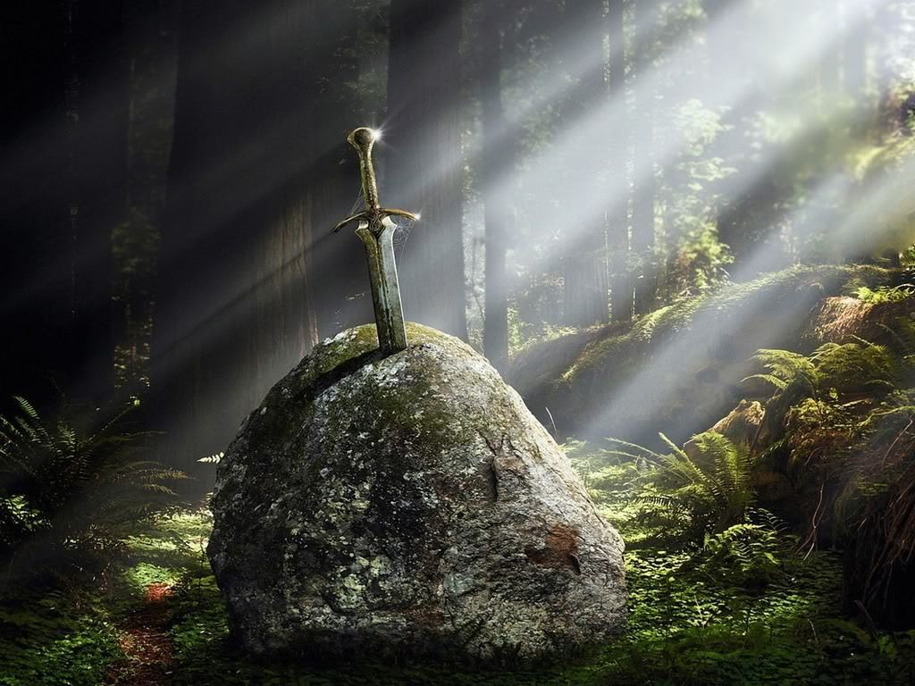
King Arthur
Dallas Lillie
Wyatt Hammond
http://images4.fanpop.com/image/photos/17000000/Excalibur-king-arthur-17029845-1024-768.jpg

Slide 13
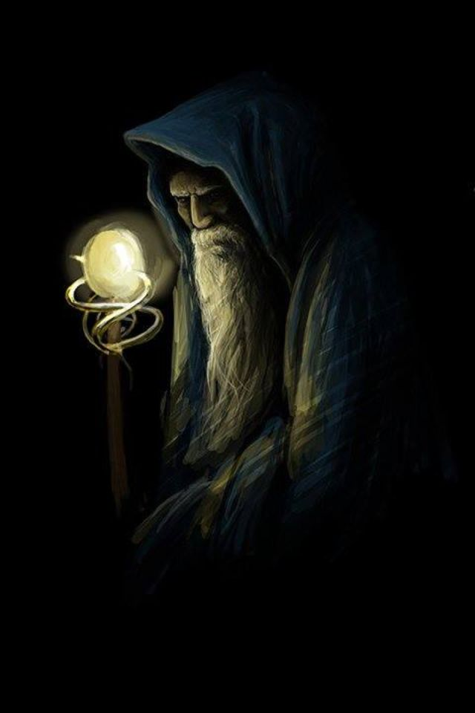
Merlin
Mitchell Martin
http://media-cache-ak0.pinimg.com/736x/ea/47/83/ea4783c4c2ff6fd196eba02286f4f2ac.jpg

Slide 14
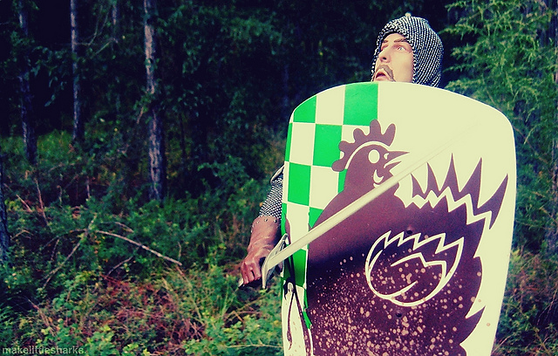
Brave Sir Robin
http://farm7.staticflickr.com/6164/6189078875_c84008e97d_z.jpg

